Slide 1


Slide 2
objectives
Derive eigenvectors and their eigenvalues from image and spectral data
Convert a digital camera into a spectral images using principal components analysis
Eigenvectors/eigenfaces are analogous to how a bunch of weighted sines and cosines reconstruct signals through linear superposition.
Spectral metrics quantify facial reconstruction similarity but outliers in the dataset tend to go around these metrics.
PCA can compress large datasets into small representative eigenvectors, effectively reducing its dimensionality.
Physics-301/Activity 03 - PCA for Compression .ipynb at main · reneprincipejr/Physics-301 (github.com)
https://drive.google.com/file/d/1WPMBsni7iw4YS_oNa47vaFy5YixpR_sG/view?usp=sharing

Slide 3
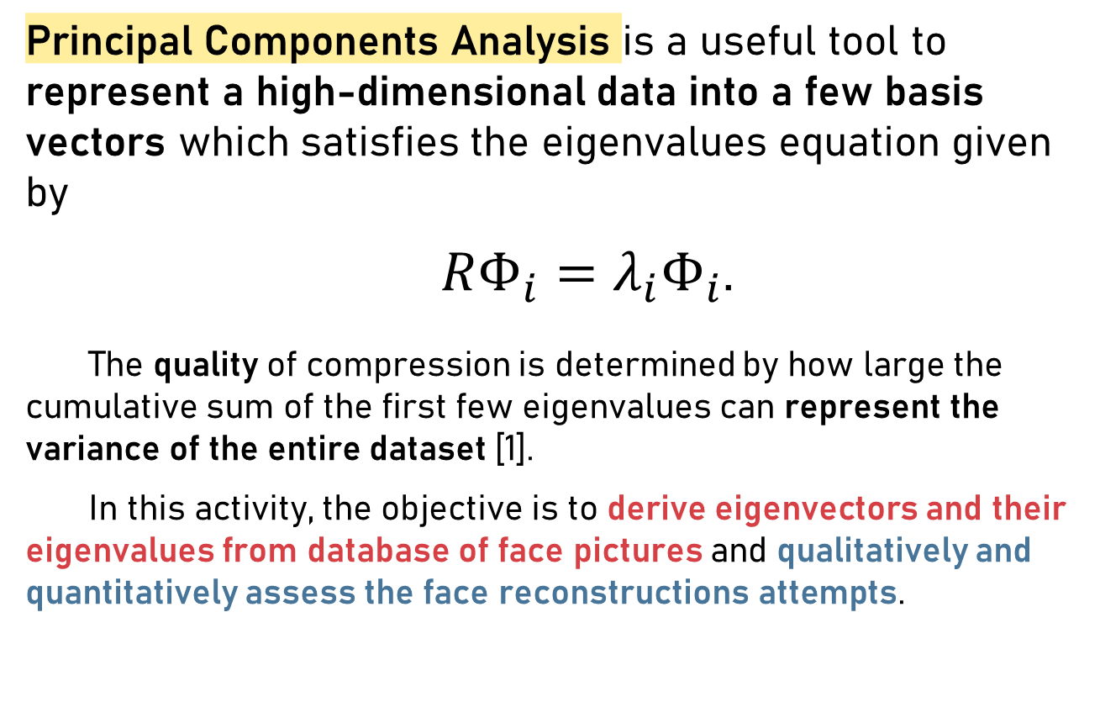
Background
Principal Components Analysis is a useful tool to represent a high-dimensional data into a few basis vectors which satisfies the eigenvalues equation given by
$RΦ_{i}=λ_{i}Φ_{i}$.
The quality of compression is determined by how large the cumulative sum of the first few eigenvalues can represent the variance of the entire dataset [1].
In this activity, the objective is to derive eigenvectors and their eigenvalues from database of face pictures and qualitatively and quantitatively assess the face reconstructions attempts.

Slide 4
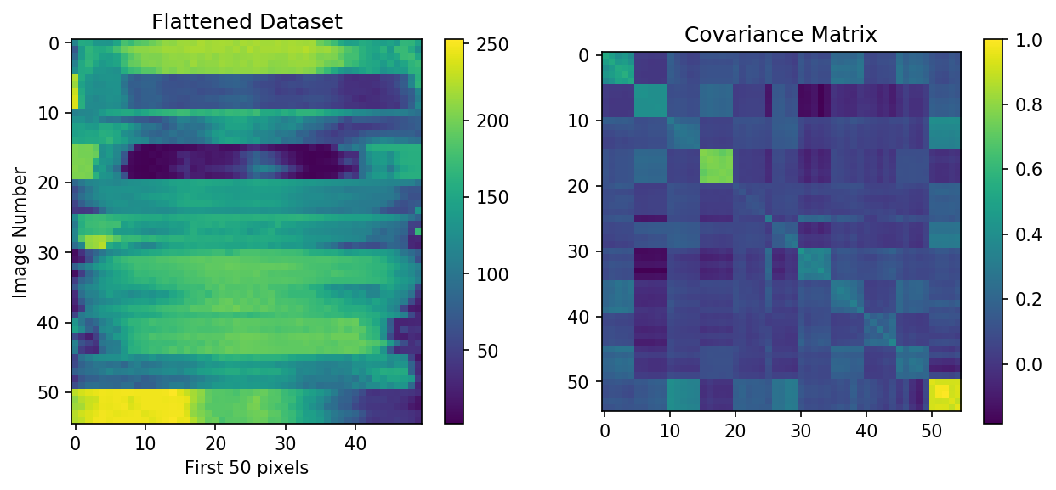
Dataset Mosaicking
11 sets of 5 face pictures were compiled and mosaicked into a 55x2500 concatenated image. This flattened dataset and its covariance matrix are shown below. The sets are distinguishable given the separability on every five-index interval along y. Then, we use the sklearn.decomposition in Python to facilitate the Principal Components Analysis [2].

Slide 5
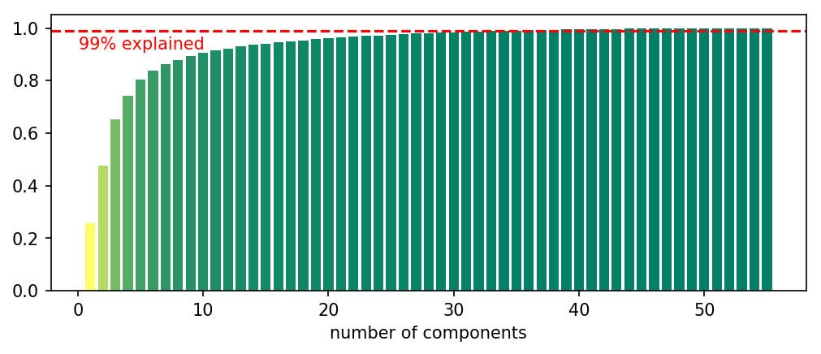
Percent Explained
Taking the cumulative sum of the normalized eigenvalues, we can see that at around 30 principal components can represent 99% of the variance in the face database. Therefore, a set of 2500 datapoints can be represented by 30 principal components with 1% error in representation, hence the “compression”.

Slide 6
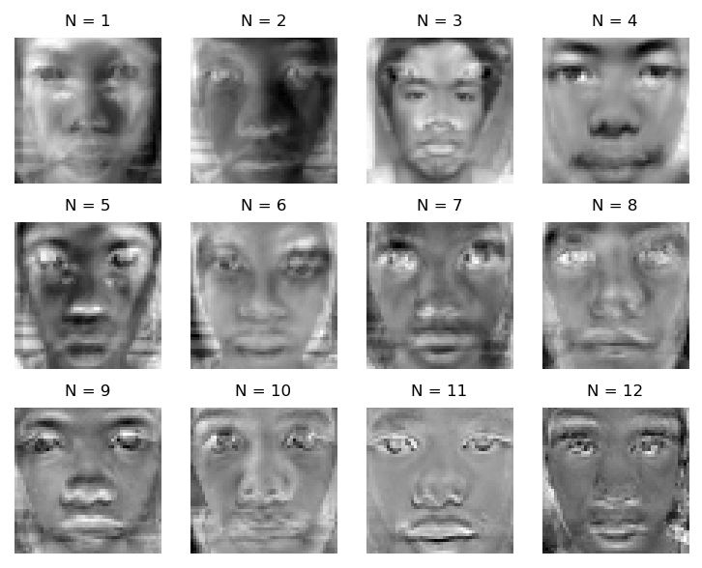
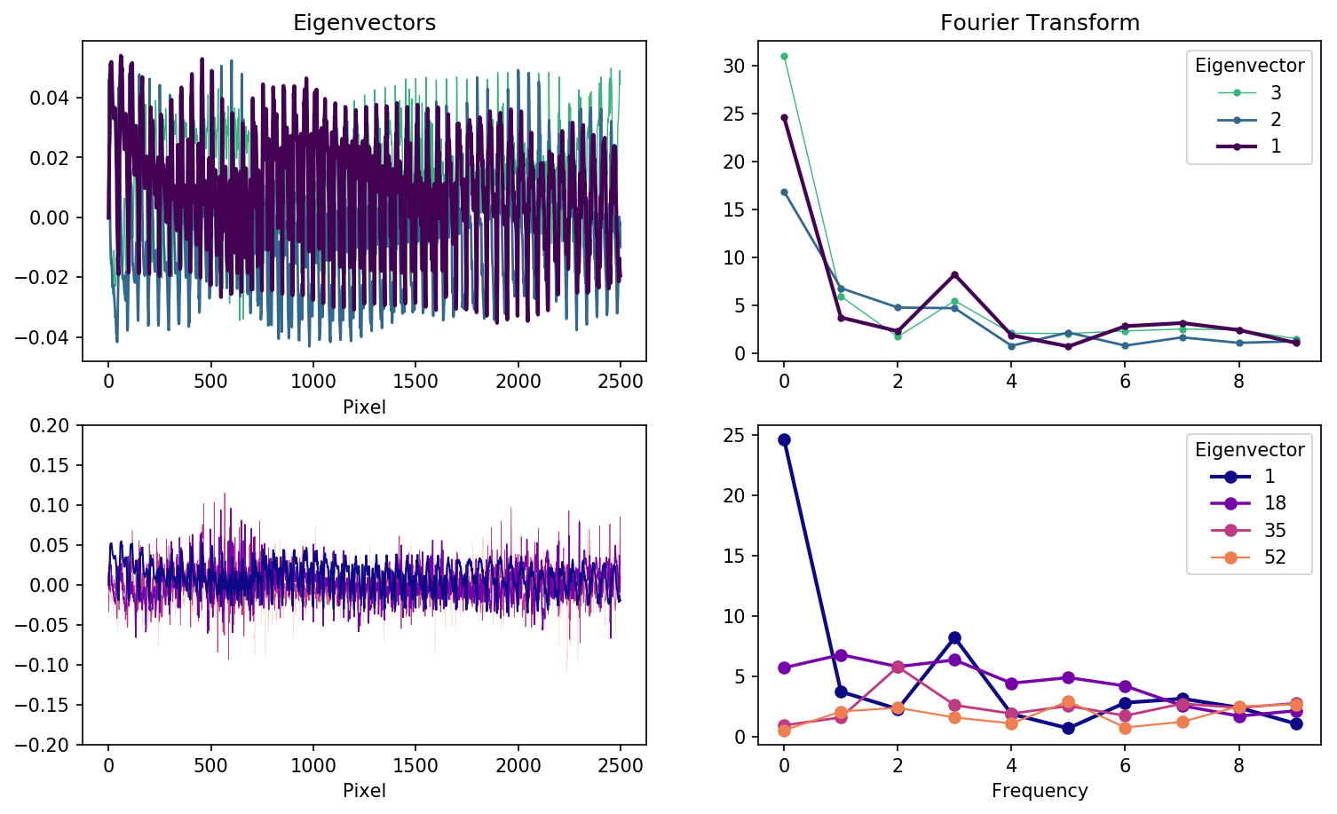
Fourier Transform
In optics, any signal can be represented as superposition of sines and cosines of varying frequency. I find this analogous to PCA’s eigenvectors which constitutes the facial reconstruction. Taking the Fourier transform reveals that indeed, each eigenvector had varying frequencies [3]. Visualizing these eigenvectors into eigenfaces, combinations of these pseudo-images constitute facial reconstruction as it is just a linear superposition of these eigenfaces weighted by the calculated eigenvalues.

Slide 7
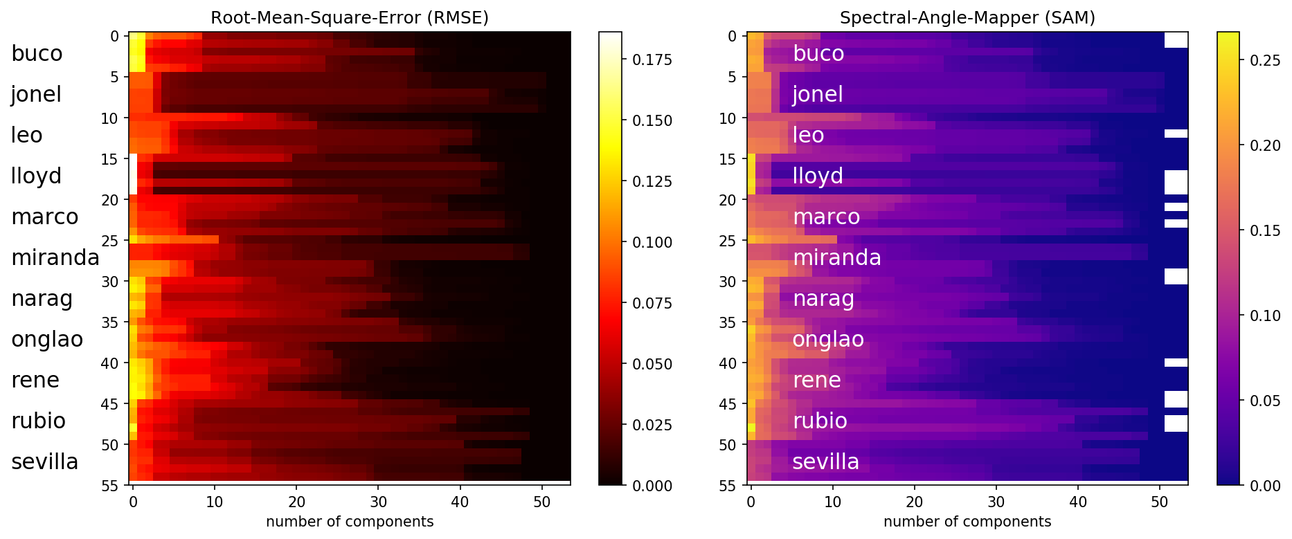

Accuracy metrics
We employed RMSE and SAM metrics which measures the residual error and structure shape similarity between the actual ${\hat{r}}_{ }$ and reconstructed $r_{ }$ faces, respectively [4]. As shown below, using more eigenfaces allows us to reconstruct better as shown by the declining errors.
$RMSE=\sqrt{\frac{\sum_{N}{(r_{ }\left(N\right)−{\hat{r}}_{ }\left(N\right))}}{n}}$ $SAM=\cos^{−1}\left(\frac{\sum_{N}{r_{ }\left(N\right)∗{\hat{r}}_{ }\left(N\right)}}{√\sum_{N}{r_{ }\left(N\right)√\sum_{N}{\hat{r}\left(N\right) }}}\right)$

Slide 8
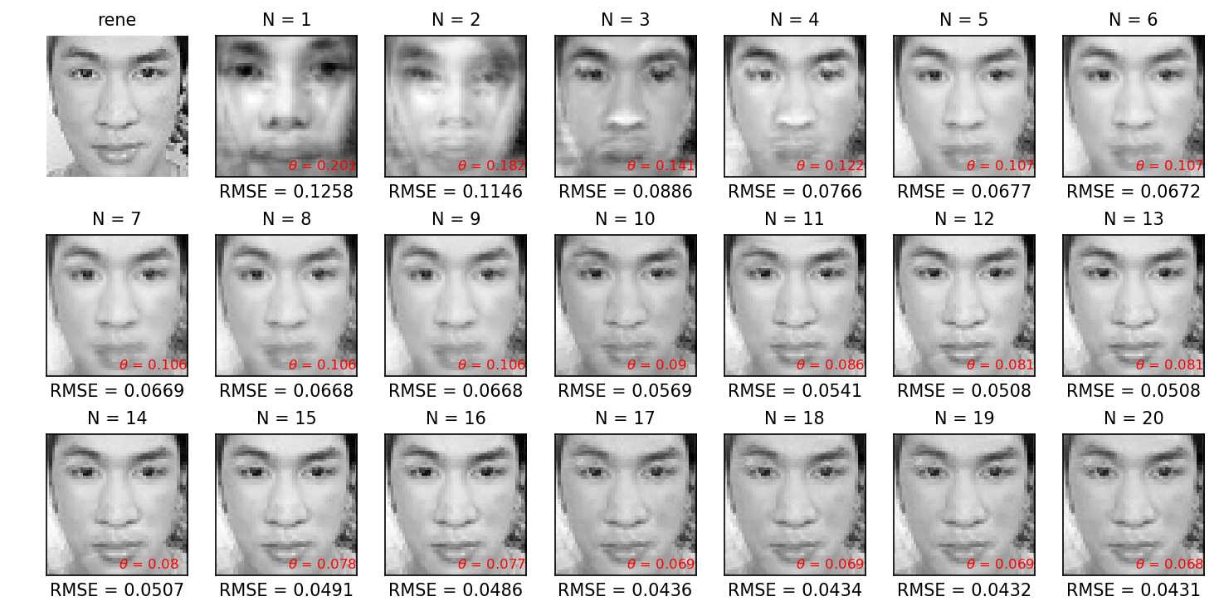
Reconstruction
Shown here is the reconstruction of my face using increasing number of principal components. At N = 5, the reconstruction is already recognizable with RMSE = 0.0677 and SAM = 0.107.

Slide 9
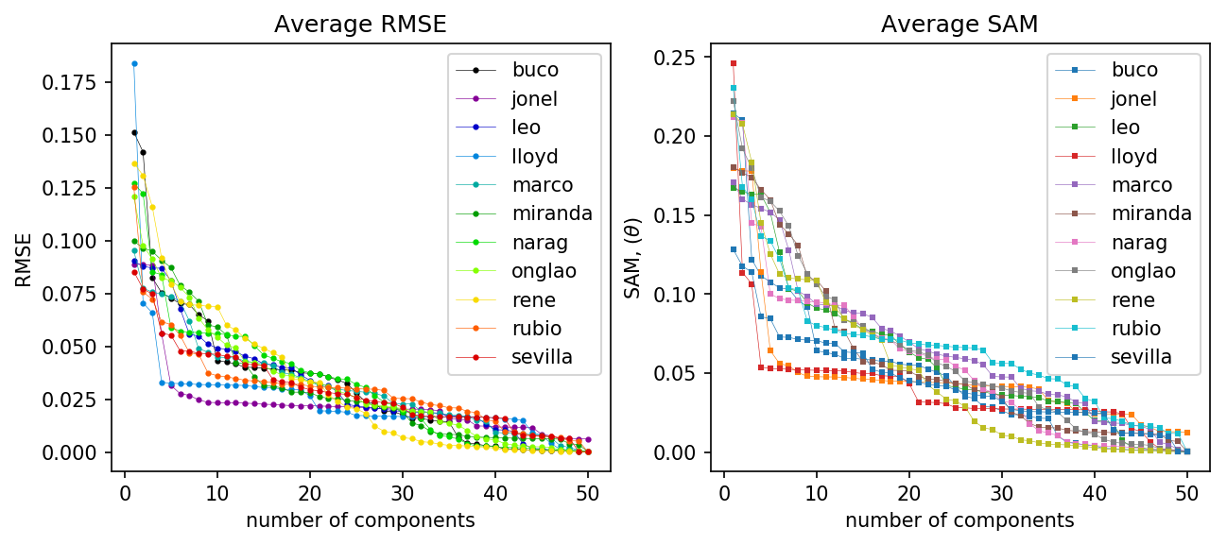
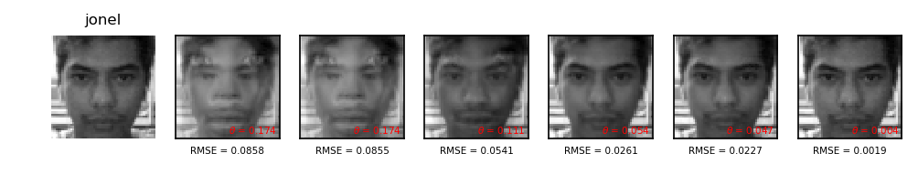
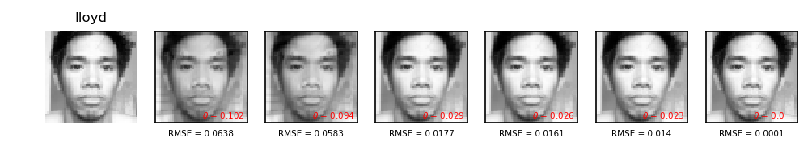
Averaging the 5 facial image reconstruction of the 11 sets, the disparity in their reconstruction errors trend are mainly attributed to the quality of capture. Jonel and Lloyd’s error values were low, but they are considered as outliers because unlike the rest of the dataset, their images contain captures of their entire head, hence unaligned with the rest of the data.

Slide 10
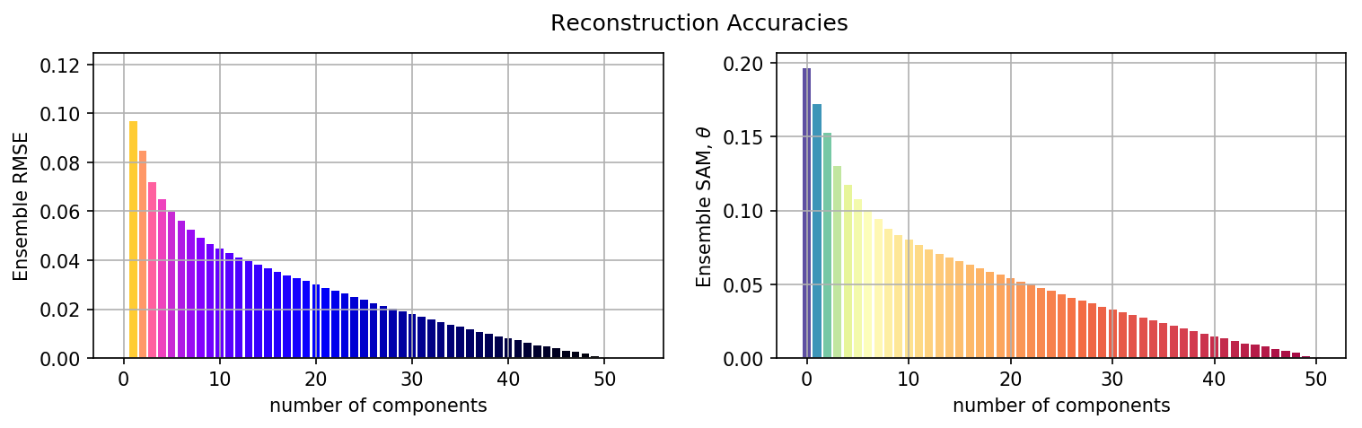
Conclusions
Overall, we demonstrated how PCA can compress large datasets into small representative eigenvectors and we’ve shown how sufficient the reconstruction were using RMSE and SAM metrics.
Real-world data are high-dimensional in nature and in fact, compression techniques like these are useful to optimize the usage of resources need to transfer information.

Slide 11
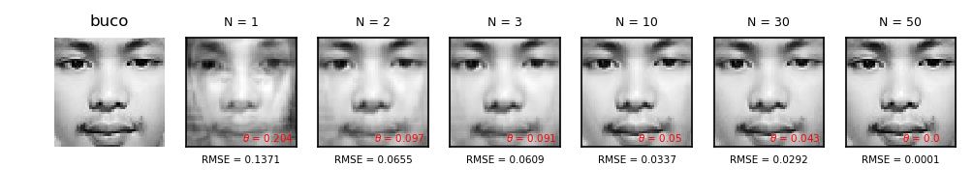
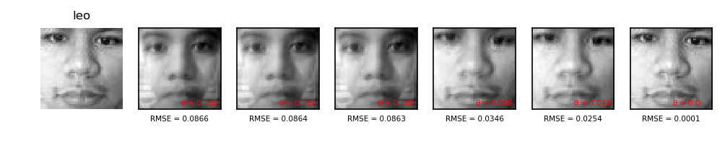
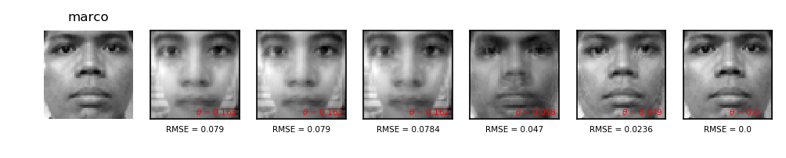

Slide 12
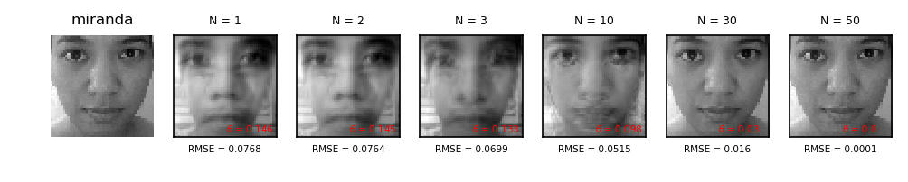
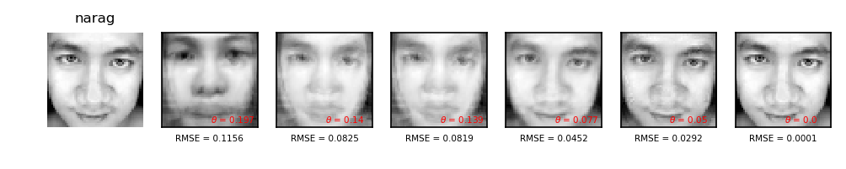
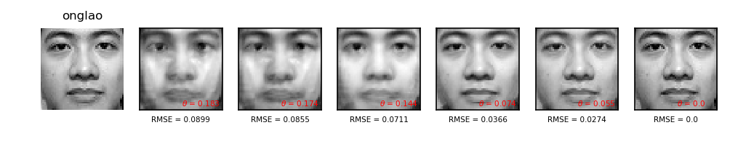
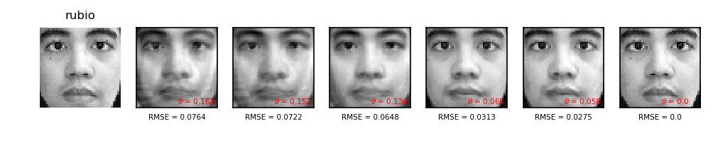
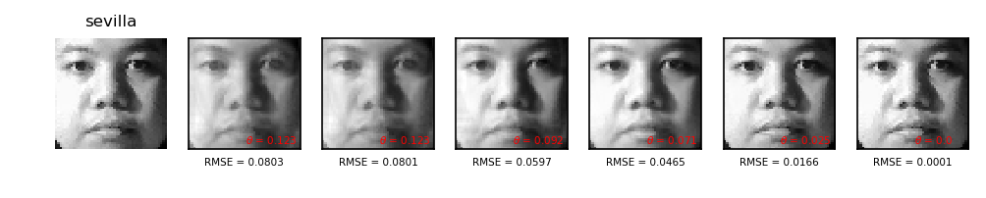

Slide 13
reflection
In my undergraduate skill building training, Dr. Soriano has guided me step-by-step in understanding how Principal Components Analysis works and so, I’d like to give her credit for my smooth execution of this activity. In fact, before I used machine learning, PCA is a state-of-the-art regression technique which I used in reconstructing spectra (which I’ll do in Activity 4). This activity one of the most exciting because we got to work with actual images. I’d like to thank my classmates for providing the face dataset that was used in this activity. More than the technical skillset satisfaction, I’m elated with the realization as to how everything is very much related to each other. Imagine reconstructing a face with just 5 inputs! Out of excitement, I think I went beyond as I measured the eigenvector frequencies, quantified the reconstruction accuracies, discussed the outlier results, and provided sufficient visualization.
In this activity, I’d give myself a score of 100/100.
[1] M. Soriano, Physics 301 – Principal Components Analysis for Compression, (2022).
[2] sklearn.decomposition.PCA — scikit-learn 1.1.1 documentation
[3] Discrete Fourier Transform (numpy.fft) — NumPy v1.22 Manual
[4] P. E. Dennison, K. Q. Halligan, and D. A. Roberts, A comparison of error metrics and constraints for multiple endmember spectral mixture analysis and spectral angle mapper, Remote Sens. Environ. 93, 359 (2004).

